Slide 1


New version of
ILAC
P15
Main changes
ILAC Inspection Committee
WG 6 -

Slide 2
New version of
ILAC
P15
This document provides information for use by both accreditation bodies and inspection bodies on the application of ISO/IEC 17020.
This revision includes updates as a result of the outcome of the ILAC Inspection Committee workshops, ISO CASCO clarification requests and the experience gained in the application of ISO/IEC 17020:2012 and the previous version of ILAC P15.
Main changes
ILAC Inspection Committee
WG 6 -

Slide 3

Revision
project timeline

Slide 4


Implementation
Date
The implementation date is
18 months
from the date of publication on the ILAC website
(i.e November 2021).

Slide 5
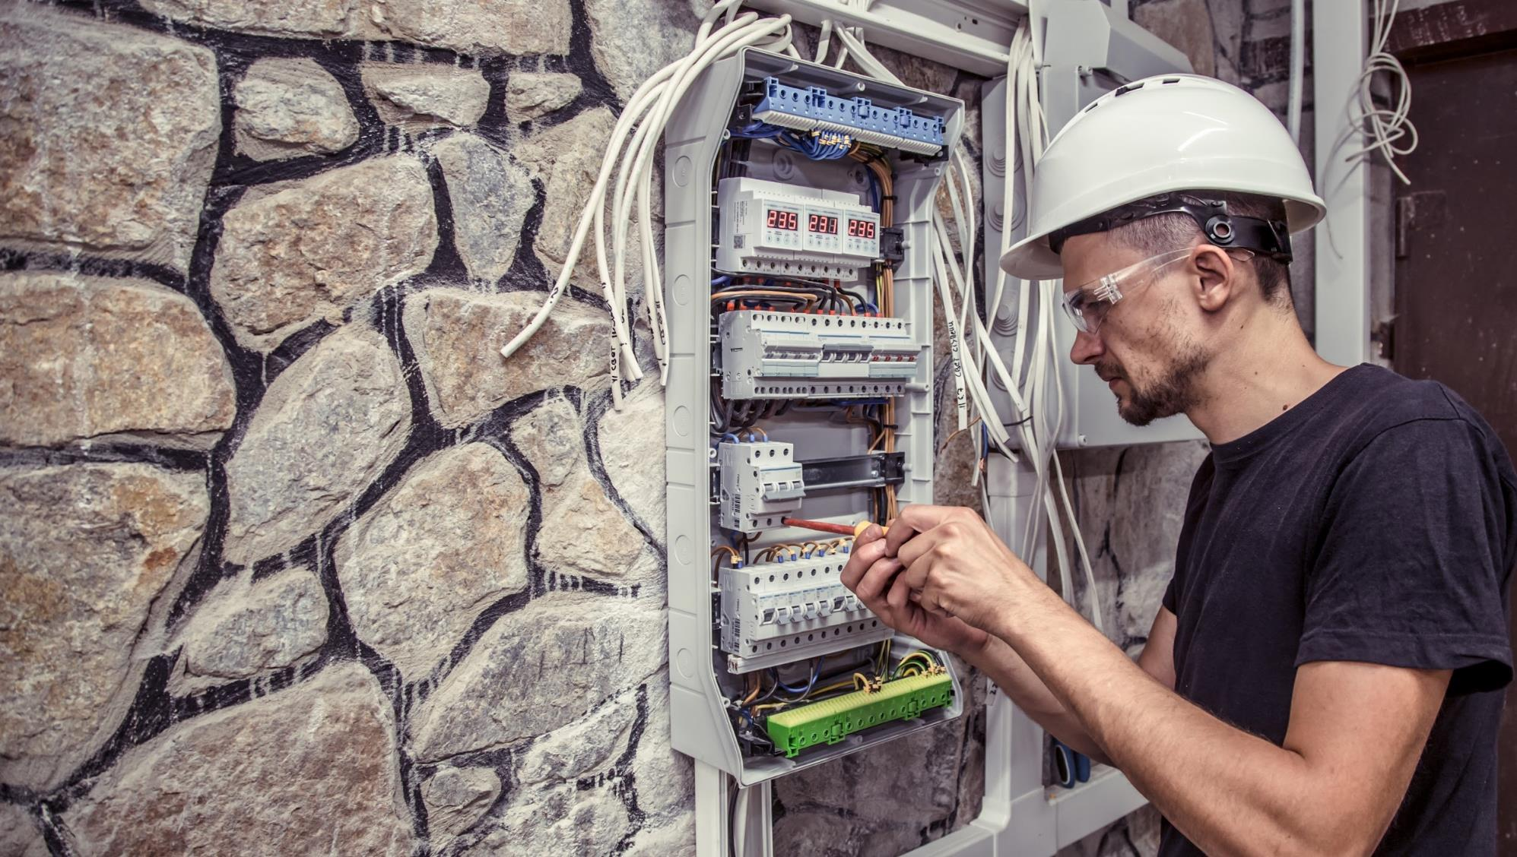
Content:
Clarification of concepts
Removal of examples
Addition of Annexes
New technologies
Consideration of new standards and guidance
List of changes
Sources of changes
Main
Changes

Slide 6


Clarification of
I
Concepts
”ongoing basis ” (4.1.3)
” impartiality risk analysis ” (4.1.3 + Annex 1)
” control measures ” (4.1.4 + Annex 1)
”adequacy” , ” adequate provision” (5.1.4)
” maintain the capability ” (5.2.2)
” mentored working period ” (6.1.6)
” examination only inspection ” (6.3.3)
” Regulatory requirements ” (Annex A n3)

Slide 7



II
Removal of
examples
ilac.org/about-ilac/faqs/
Examples added to the FAQs:
  P15 is a mandatory document -> examples can be confused with implementation notes
  A lighter document with clear clauses

Slide 8


III
adding
informative
Annexes
Annex 1: Possible format for an impartiality risk analysis (Informative)
Annex 2: Relationship between impartiality and Type A independence requirements (Informative)

Slide 9


Annex 1:
Possible format for
impartiality risk analysis

Slide 10


Annex 2
Relationship between
Impartiality
Type A independence requirements
&
Some risks eliminated by complying to Type A independence requirements
Impartiality Risk Analysis and Control Measures
Items Inspected
Type A / Type C

Slide 11

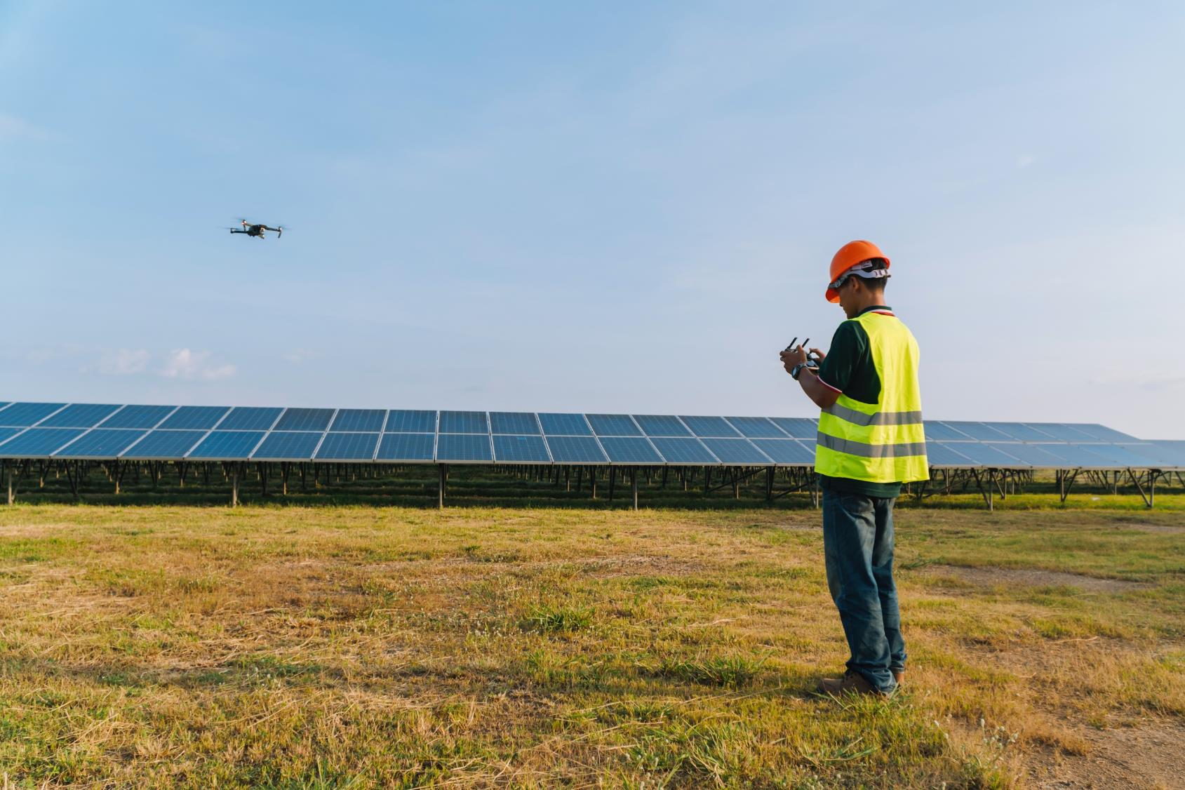
drones, cameras, special glasses, IT, artificial intelligence, etc.
adding
Guidance on
New technologies
IV
Validation of the new or changed methods
understanding all significant issues and technologies
applicable legal and safety requirements , limitations and conditions

Slide 12

Considering new
Standards & guidance
V
New ISO/IEC 17025
the ISO CASCO clarifications
new versions of ILAC G24, G27 and P8
consensus from ILAC IC workshops
agreed answers to the questions received during the last 4 years

Slide 13
Considering new
Standards & guidance
V
Confirmation of the term “items inspected”
Clarification of the independence requirements
use of non accredited subcontractors
measurements performed as part of inspection

Slide 14


VI
List of changes

Slide 15
ISO/IEC 17020 | P15 2016 note | P15 2020 note | Change made | Level of change
4.1.3 | 4.1.3a | 4.1.3 n1 | Updated with focus on explaining “on an ongoing basis” | Minor change
 | 4.1.3b | 4.1.3 n2 | The inspection body should describe any of its relationships or its personnel’s | Minor change
 |  | 4.1.3 n3 | Reference to Annex 1 gives an example of a possible format for impartiality risk analysis | New
4.1.4 |  | 4.1.4 n1 | Explanation of the threats and inducements aimed at inspectors or other inspection body personnel and they should be aware of | New
4.1.6 |  | 4.1.6 n1 | Guidance on the possibility of an inspection body to have different types of independence (Type A, B or C) | New
 |  | 4.1.6 n2 | Clarification of the fact that complying with the Type A independence requirements A.1b and A.1.c is binary (yes or no) minimizing risk by control measures not possible for A.1b and A.1.c. | New
5.1.3 | 5.1.3a | 5.1.3 n1 | Adding reference to ILAC G28 for formulation of scopes | Minor change
5.1.4 | 5.1.4a | 5.1.4 n1 | liabilities that may arise from the inspection body’s activities. | Minor change
 |  | 5.1.4 n2 | Guidance on assessment of ‘adequacy’ and factors taken into account by the IB when determining what constitutes “adequate provision”. | New
5.2.2 | 5.2.2b | 5.2.2 n2 | Adding that being up to data with schemes developments is part of IB capability maintenance | Minor change
5.2.4 | 5.2.4a | 5.2.4 n1 | Clarification of reason for relevance of information on the mentioned personnel
5.2.5 | 5.2.5b | 5.2.5 n2 | Reference to new technologies | Minor change
6.1.1 | 6.1.1a | 6.1.1 n1 | Reference to the case where competence requirements are already defined by regulators and scheme owners | Partially New
6.1.6 | 6.1.6a | 6.1.6 n1 | The “mentored working period” mentioned in item b should include participation in inspections at the locations where these inspections are performed | Minor change
6.1.9 | 6.1.9a | 6.1.9 n1 | Replacing “ positive outcome of report reviews, interviews, simulated inspections and other performance assessments” with “positive monitoring” | Minor change
 | 6.1.9c | 6.1.9 n3 | note reworded | Minor change
6.1.11 | 6.1.11a |  | note removed | removed
6.2.1 | 6.2.1a |  | Example removed | removed
6.2.4 |  | 6.2.4 n1 | Implementation note on documenting and retaining rationale related to significance of equipment on results | New
 | 6.2.4c |  | Moved under 6.2.6 | Moved
6.2.7 | 6.2.7b | 6.2.7 n2 | Clause rewarded | Minor change
 | 6.2.7c |  | Removed | Removed
6.2.8 | 6.2.8a |  | Removed | Removed
6.2.13 | 6.2.13a |  | Removed | Removed
6.3.1 | 6.3.1a |  | Removed | Removed
6.3.4 |  | 6.3.4 n1 | Implementation note on the competence of subcontractors | New

Slide 16
ISO/IEC 17020 | P15 2016 note | P15 2020 note | Change made | Level of change
7.1.1 |  | 7.1.1 n1 | Reference to ILAC g27 if the inspection includes measurements | New
 |  | 7.1.1 n2 | Reference to ISO/IEC 17007 for the development of specific inspection methods and procedures | New
 |  | 7.1.1 n3 | Reference t new technology used during inspections | New
7.1.3 |  | 7.1.3 n2 | Implementation note on the aspects that require attention with the introduction of new technologies | New
7.4.2 | 7.4.2a | 7.4.2 n1 | Note reworded | Minor Change
7.4.4 | 7.4.4a |  | Removed | Removed
8.2.1 |  | 8.2.1 n1 | The policies and objectives shall address the competence impartiality and consistent operation of the inspection body. | New
8.6.4 | 8.6.4a | 8.6.4 n1 | Note updated | Minor change
 |  | 8.6.4 n2 | Implementation note on Internal audit frequency and coverage | New
Annex A | Aa | A n1 | reference to 4.1.6 n1 added | Minor change
 | Ab |  | Example removed | Removed
 |  | A n2 | It is also considered as a conflicting activity the provision of consultancy in the design, manufacture, supply, installation, purchase, use or maintenance of the items inspected. | New
 |  | A n3 | Implementation note on the exception by ‘regulatory requirement’ in A3 | New
 |  | Annex 1 | Possible format for an impartiality risk analysis (Informative) | New
 |  | Annex 2 | Relationship between impartiality and Type A independence requirements (Informative) | New

Slide 17



VII
Sources of
changes
01
ILAC Docs
02
Members' Questions
03
Standards
04
Workshops
05
Stakeholders Comments
06
Regions' Docs
07
Draft Docs
08
CASCO Clarifications

Slide 18
The implementation date for ILAC P15:05/2020 is 18 months from the date of publication on the ILAC website (i.e November 2021).

Slide 19



Thank you all
For your contribution
© Copyright ILAC 2021
ILAC encourages the authorised reproduction of its publications, or parts thereof, by organisations wishing to use such material for areas related to education, standardisation, accreditation, or other purposes relevant to ILAC’s area of expertise or endeavour. The document in which the reproduced material appears must contain a statement acknowledging ILAC’s contribution to the document.

